Slide 1
Conditional Random Field [3]
Joohyung Lee

Slide 2
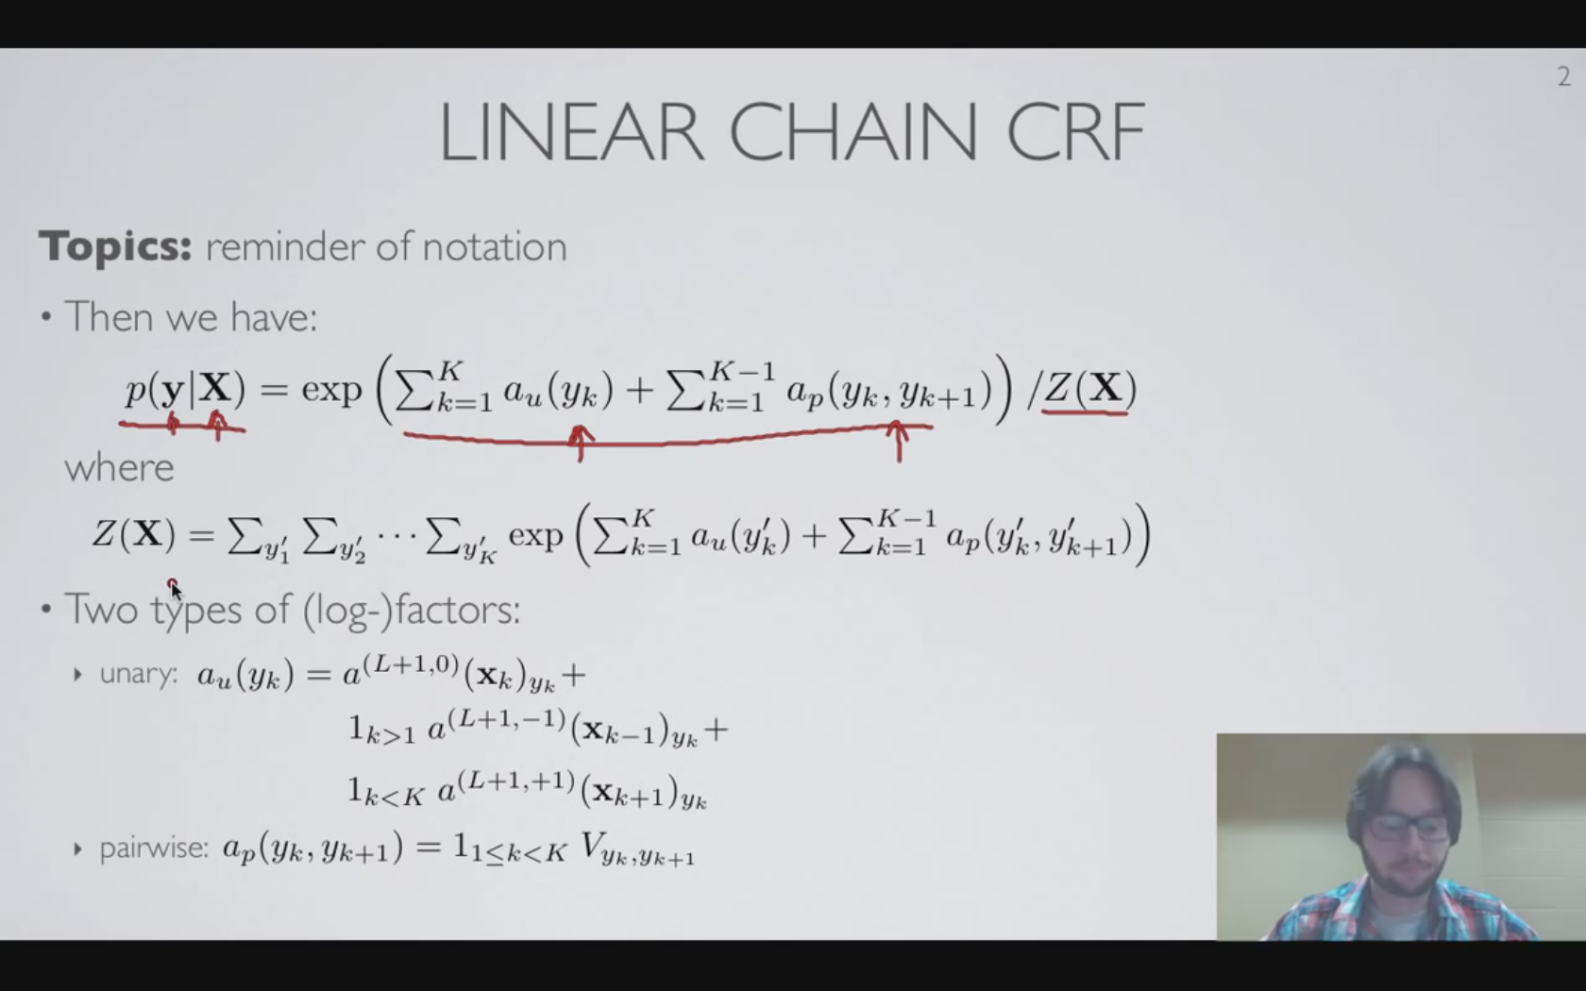
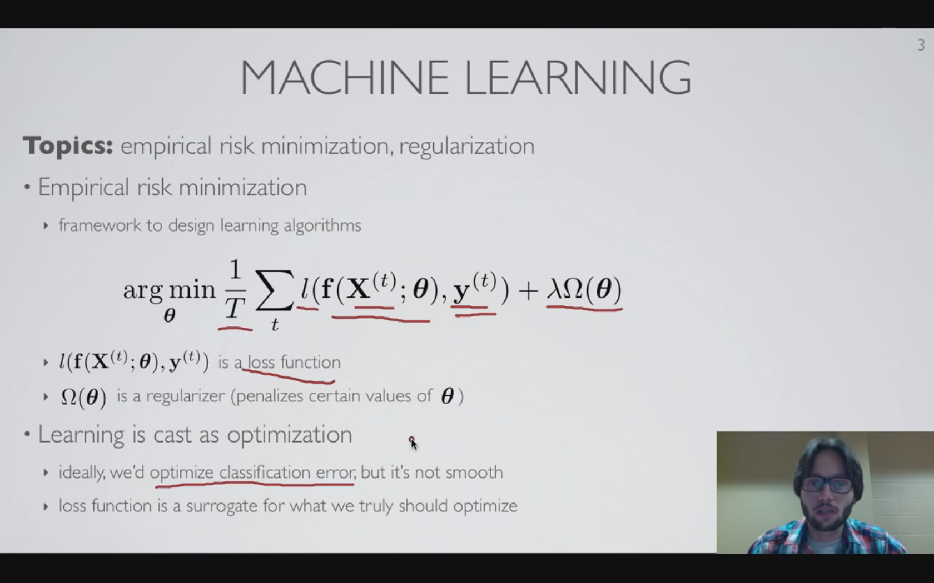
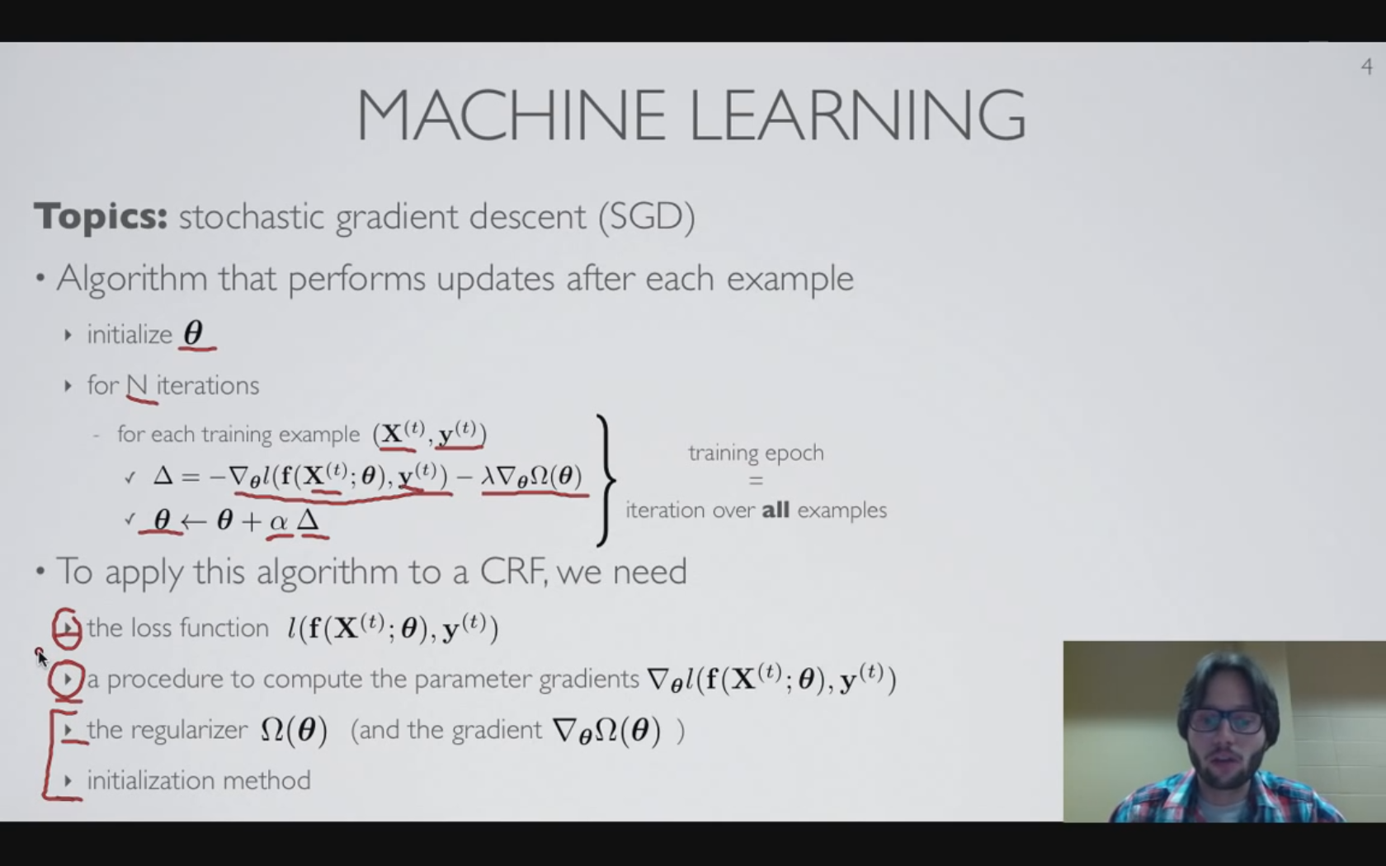
Training CRF -Loss function (to train CRF)
Previously
Definition of Linear chain CRF.
Trained network assumed
Empirical risk minimization
Machine Learning revisited
Notes:
4.1

Slide 3
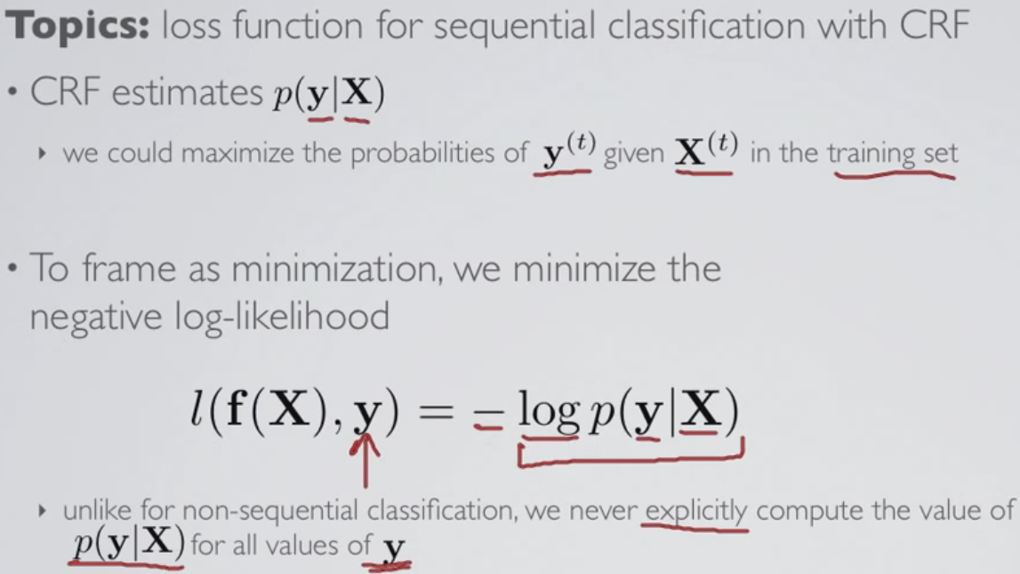
Training CRF -Loss function (to train CRF)
In CRF, we never compute the conditional probability for all the classes, but only the correct class since the computation is exponential and thus very heavy
y in –log p(y|X) is true label
Notes:
4.1

Slide 4
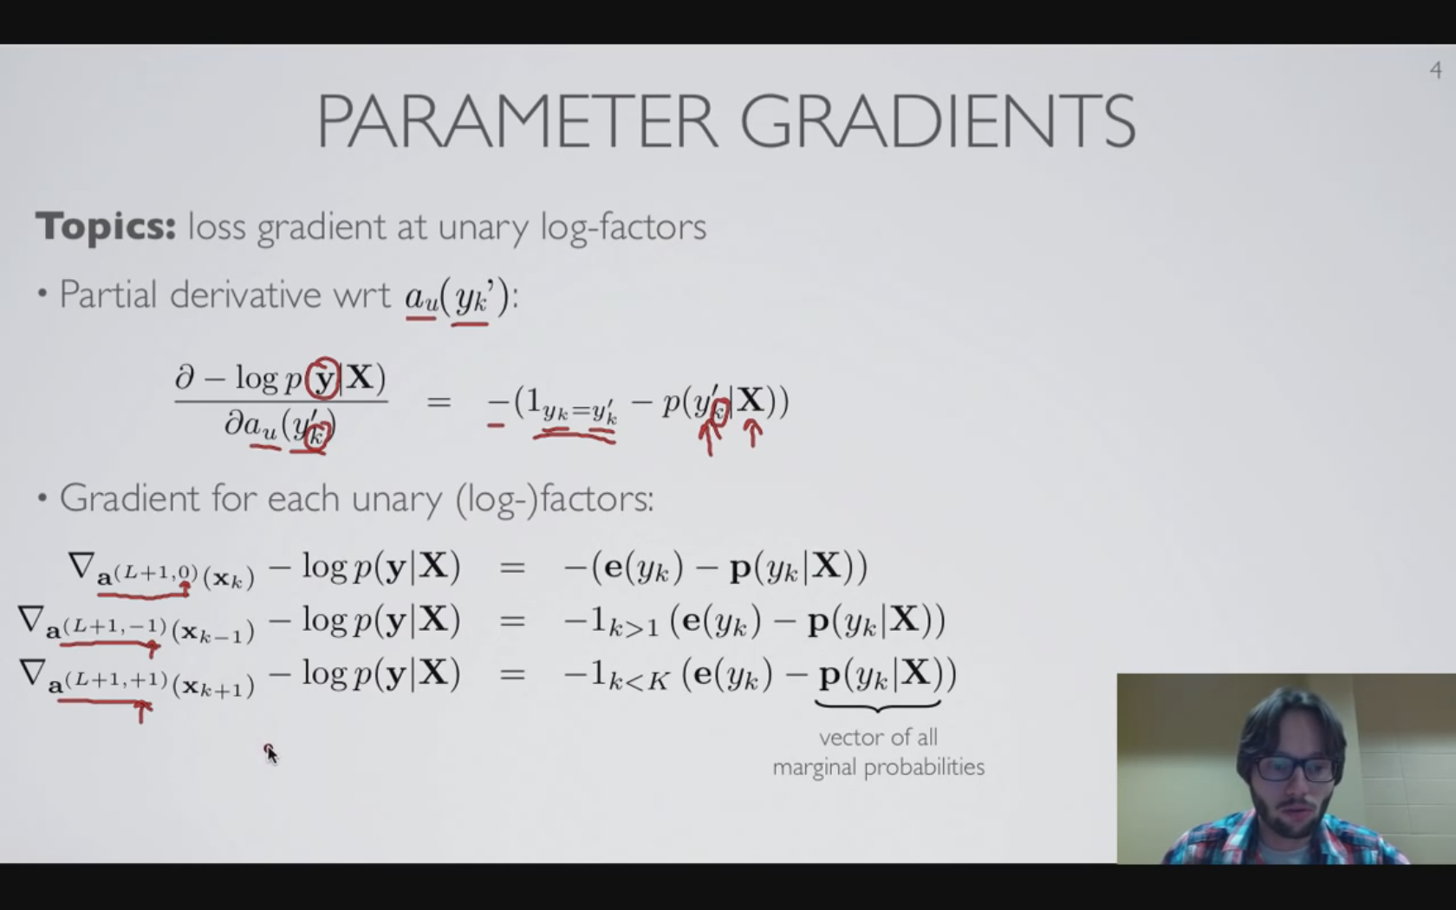
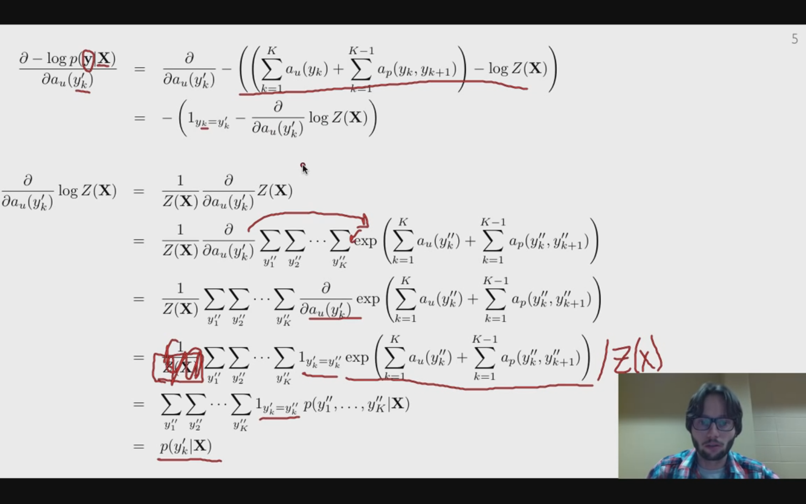
Training CRF -unary log-factor gradient
Loss: negative log of the probability of the TRUE label sequence given the input sequence
Yk is any class label so can be any (true/untrue)(observed/unobserved) class label
Similar partial derivative to that of the
Notes:
4.2

Slide 5
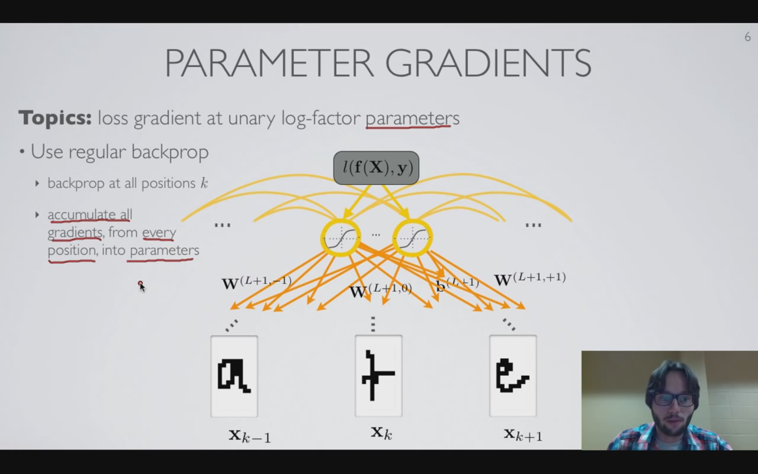
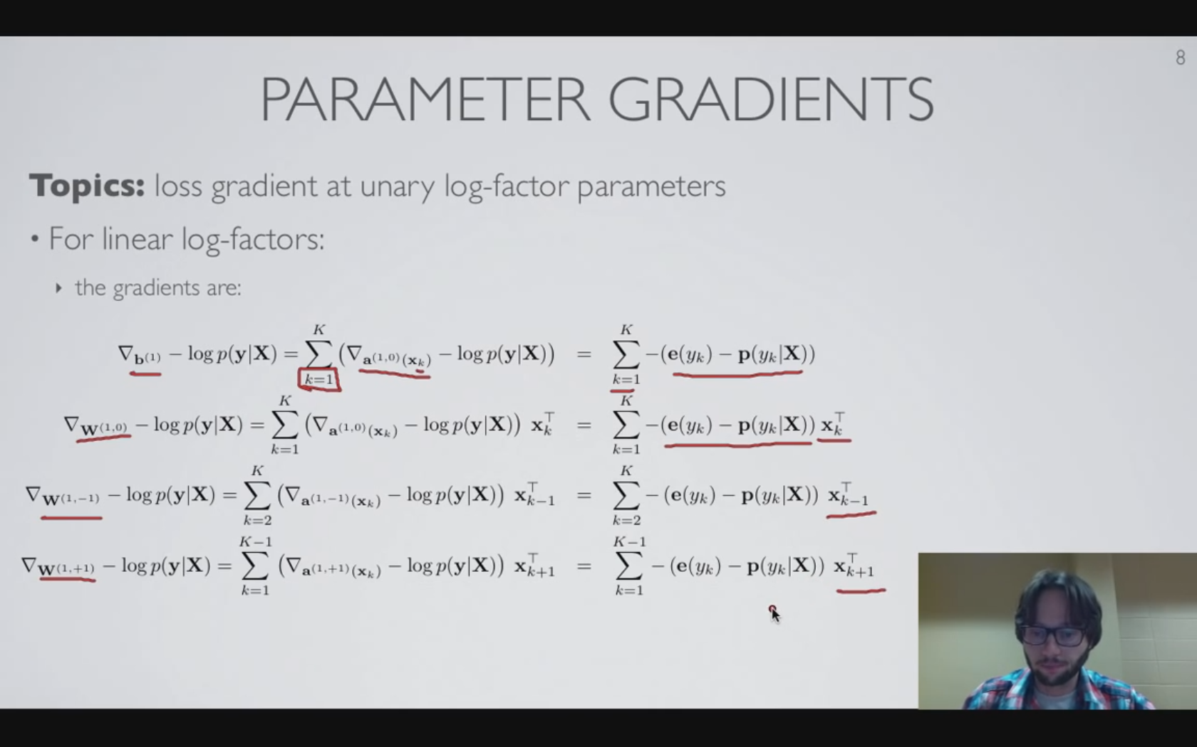
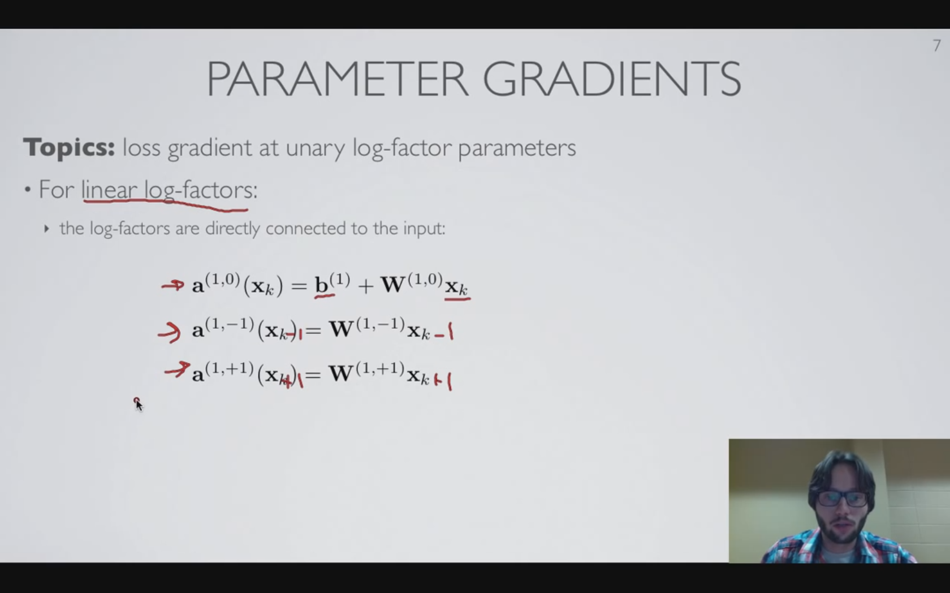
Training CRF -unary log-factor gradient
Notes:
4.2

Slide 6
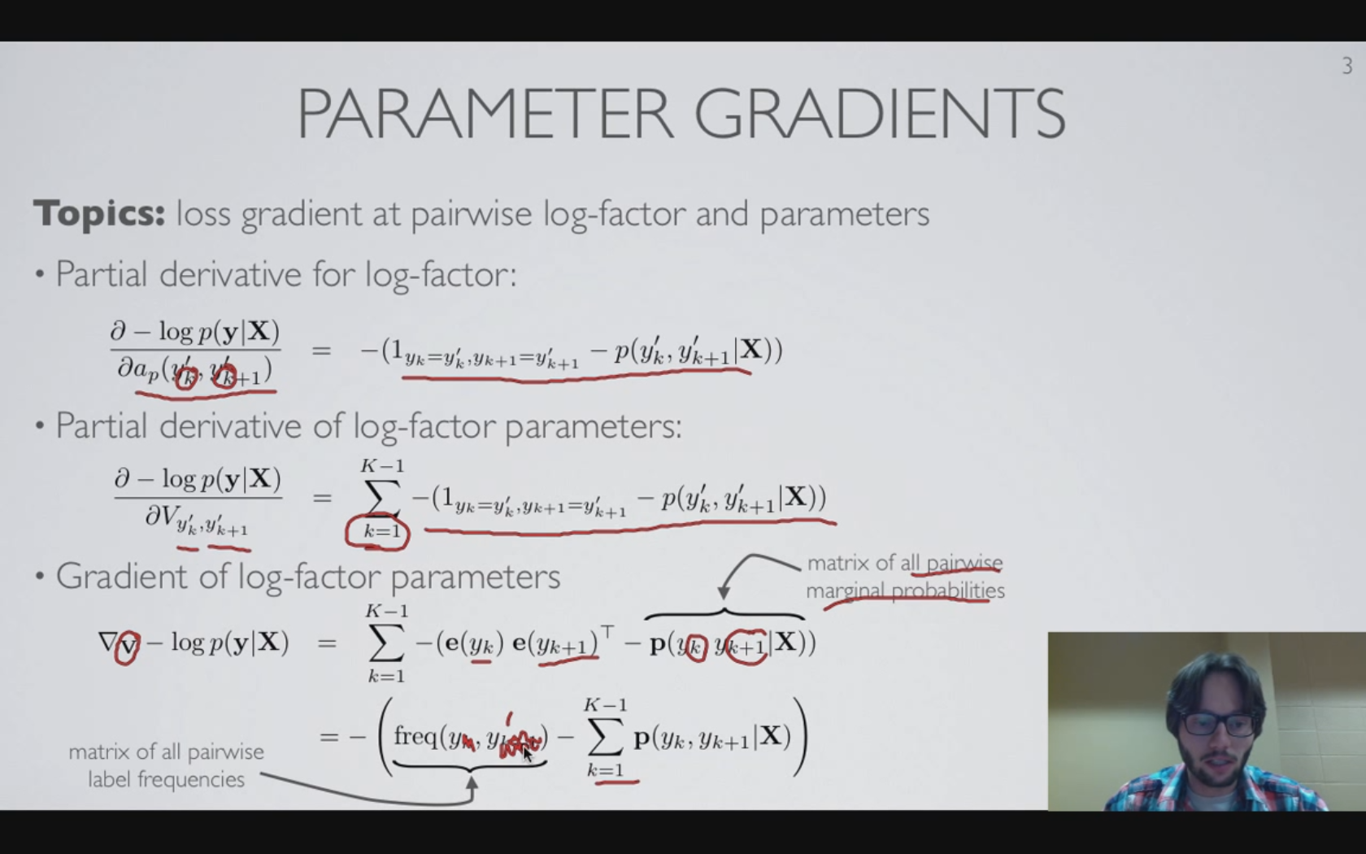
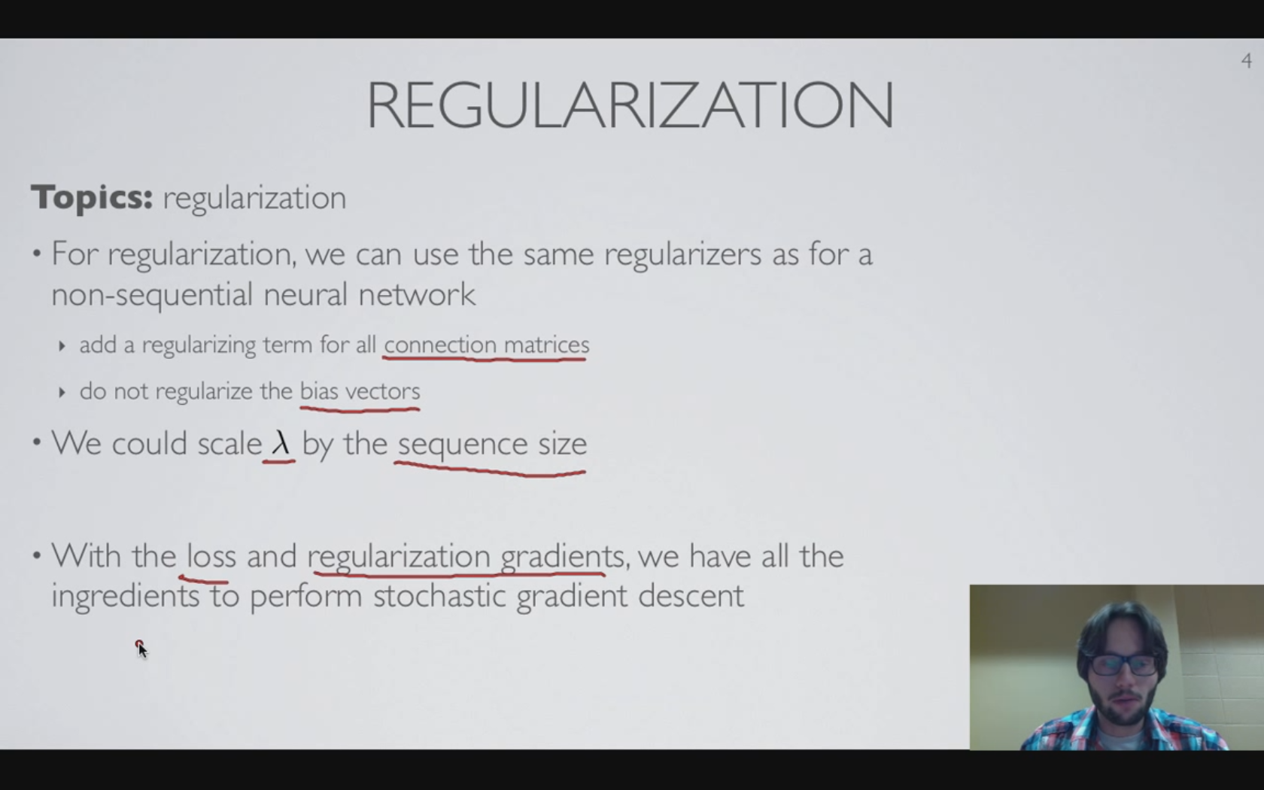
Training CRF -pairwise log-factor gradient
Couldn’t apprehend the meaning…
Notes:
End of 4.3

Slide 7
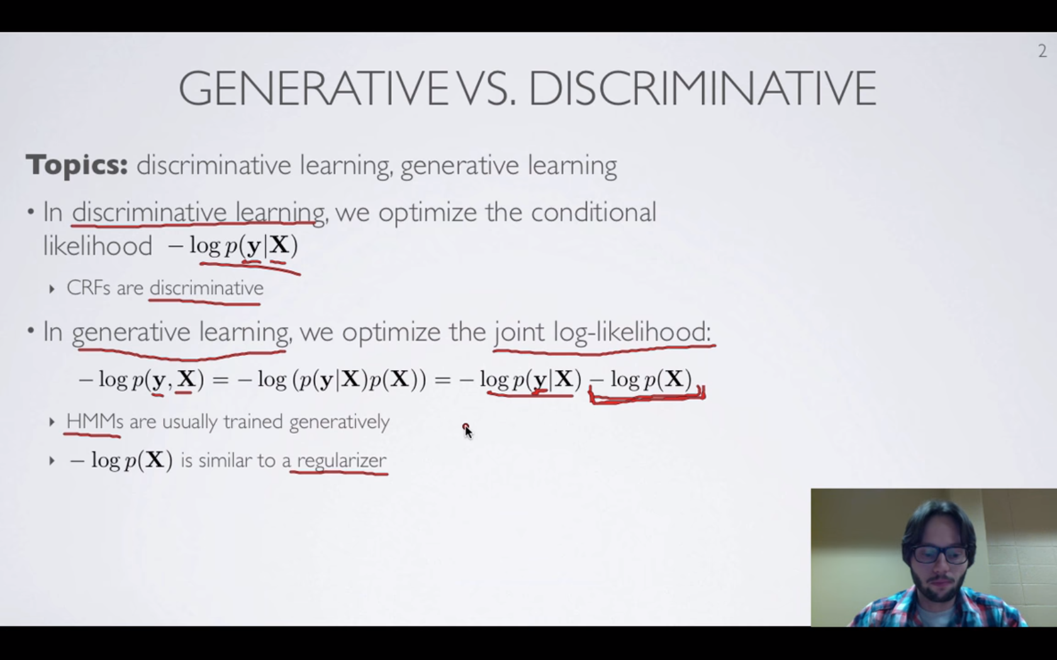
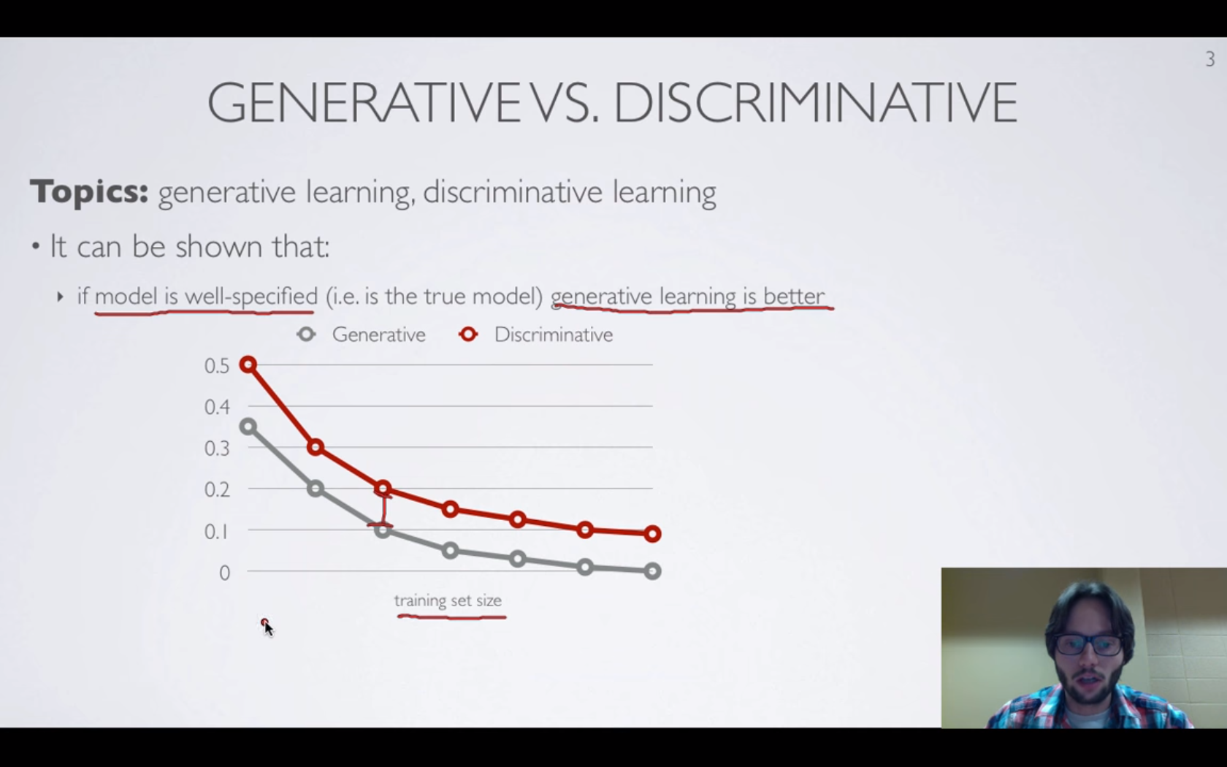
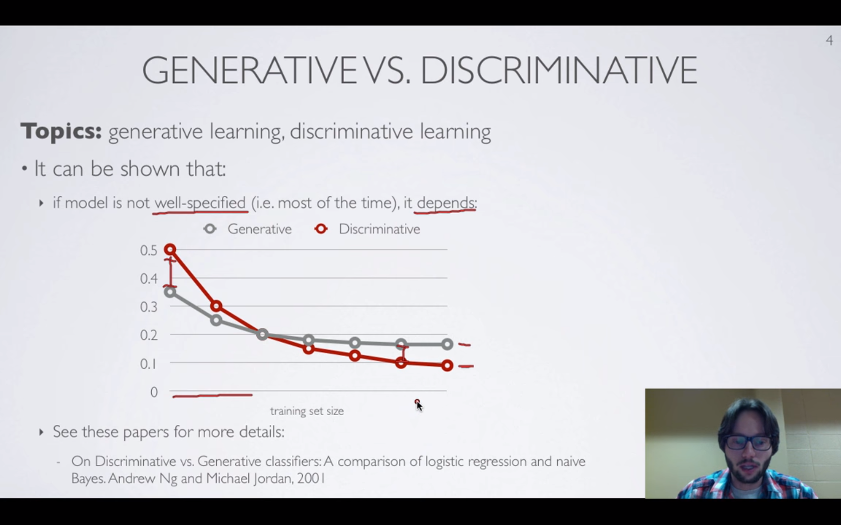
Training CRF -discriminative vs. generative learning
Due to the p(x) term which acts like a regularizer, discriminative learning fits better whereas generative learning makes some kind of smoothing.
Notes:
On Discriminative vs. Generative classifiers: A comparison of logistic regression and naïve Bayes. Andrew Ng and Michael Jordan, 2001
End of 4.3

Slide 8
Training CRF -maximum-entropy Markov model
MEMM is different from CRF in that it is directed.
Node: Random Variable.
Directed edges illustrates generative story associated behind the model.
Given the whole sequence, MEMM does not define the way that the input sequence was generated: conditional model W/O p(x) defined
Notes:
4.5

Slide 9
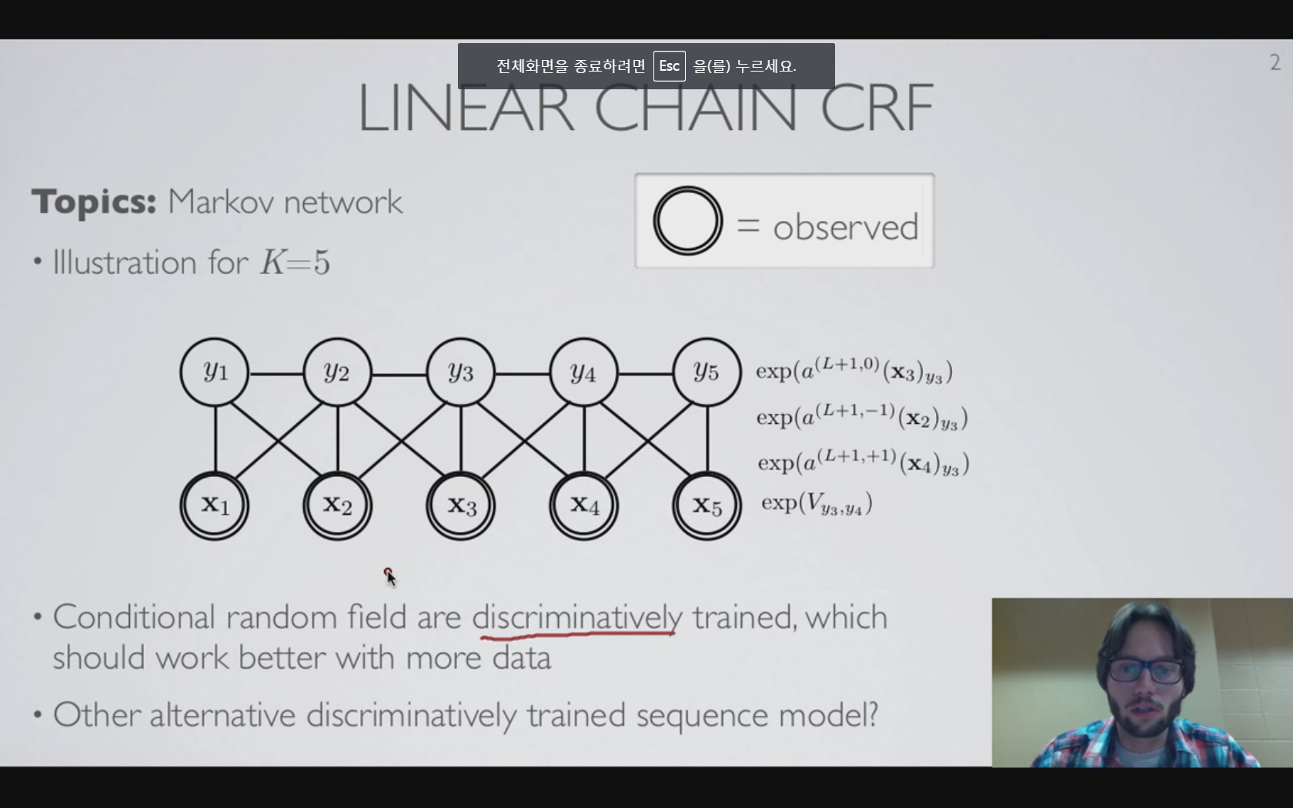
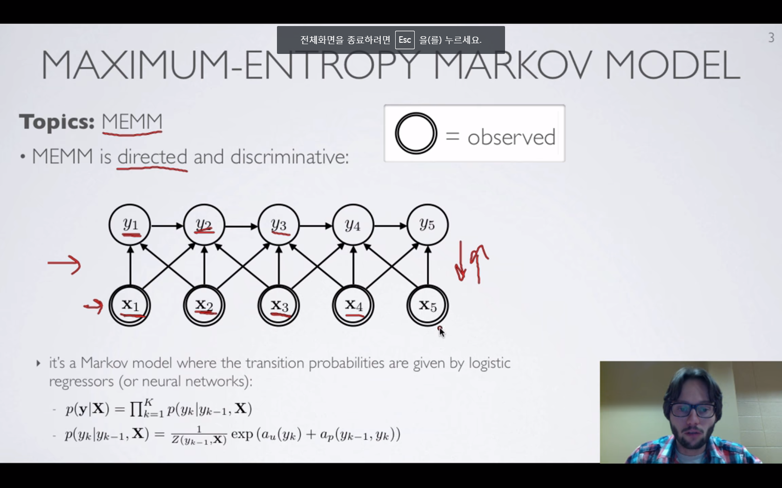
Training CRF -maximum-entropy Markov model
CRF: discriminatively trained(better way in case of abundant dataset)
MEMM: Alternative to CRF for sequence classification
HM: direction goes from the label to input
MEMM: Do not define the distribution of the input, but just CRF over the label.
Not very hard to train
Label bias problem
Small purview
Easy to train
Notes:
4.5

Slide 10
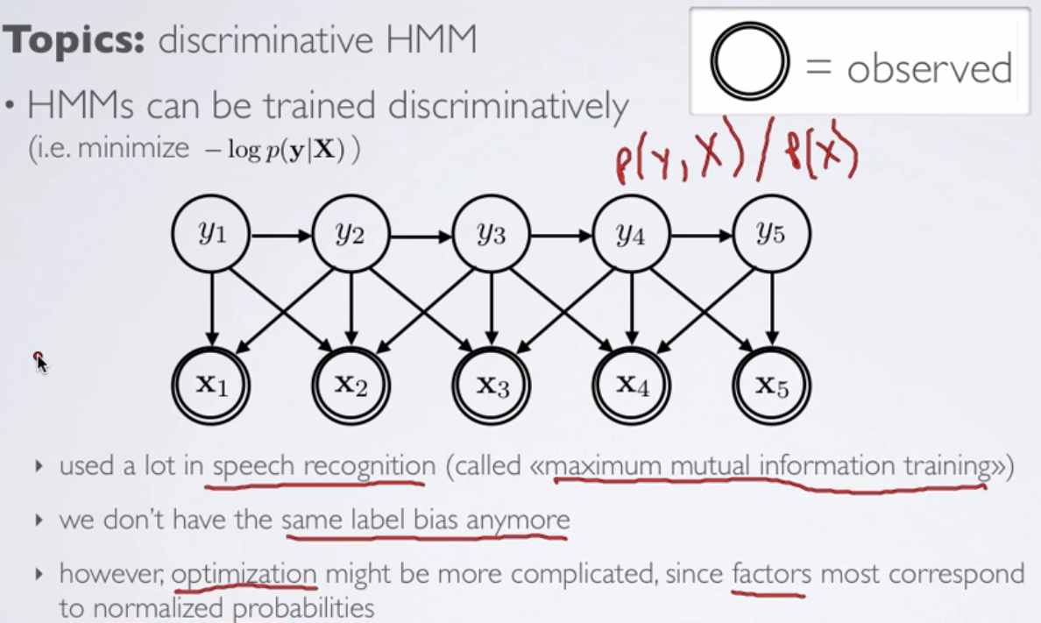
Training CRF -Hidden Markov model
HMM: Inverted generative story
Labels are produced first, which is then followed by the generation of the sequence of observations.
Get P(X|y), get p(X,y) -> get p(y|X)
Get the loss: -log p(y|X)
No more label bias problem
Involves factor normalization, which adds much complexity on optimization of model.
Finding pdf of the sequence of the observation x.
CRF (MEMM?) sidestep this problem, since it is conditional problem, though it suffers the label bias problem
Discriminative training of HMM is plausible (prevalent in the field of speech recognition) but harder than in case of Linear Chain CRF.
Notes:
4.6

Slide 11
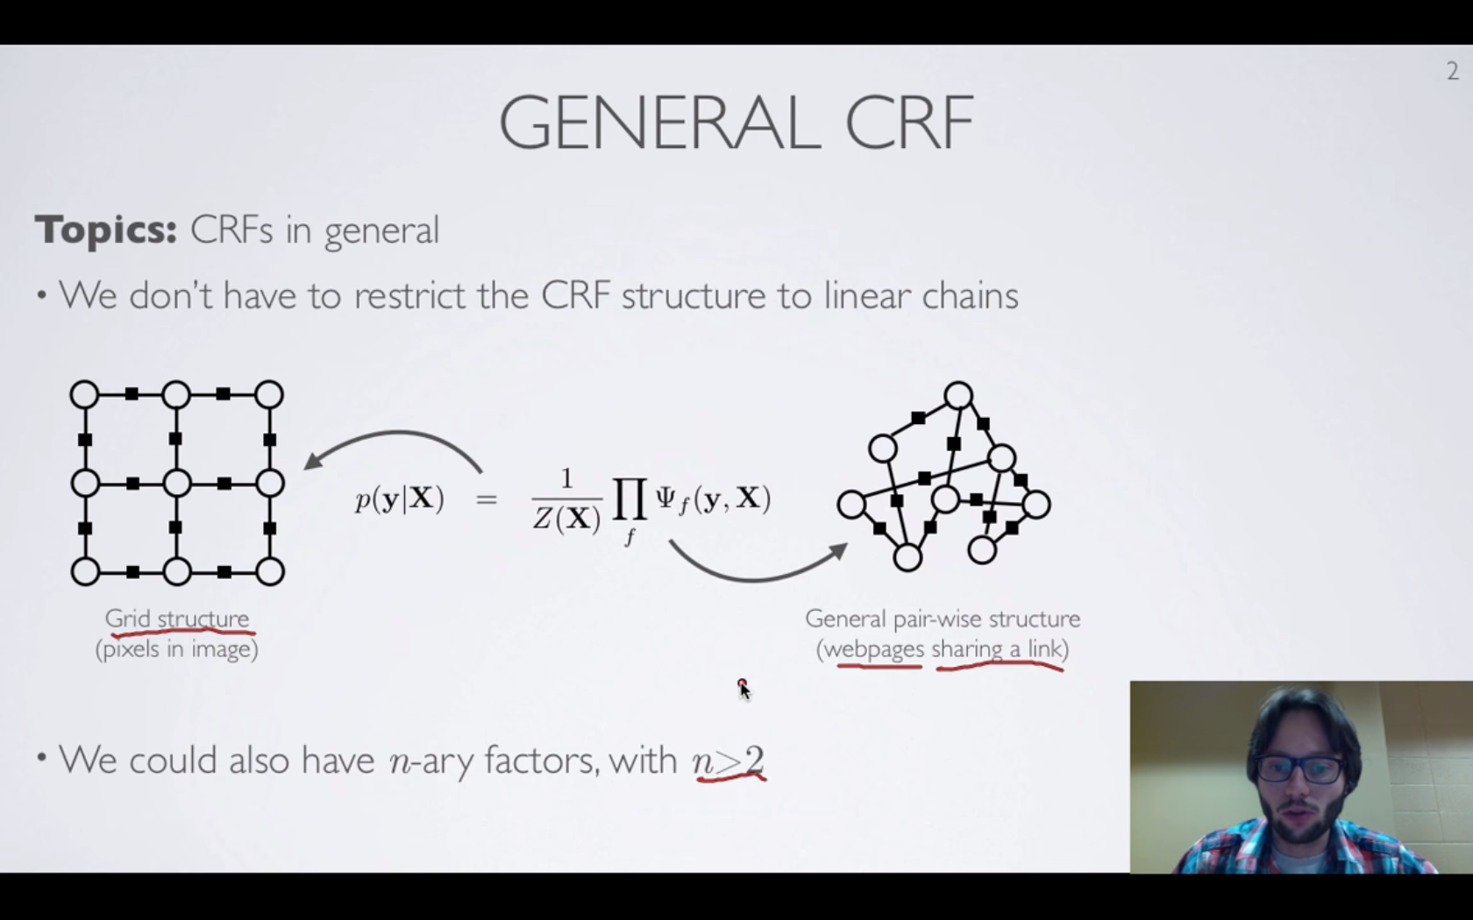
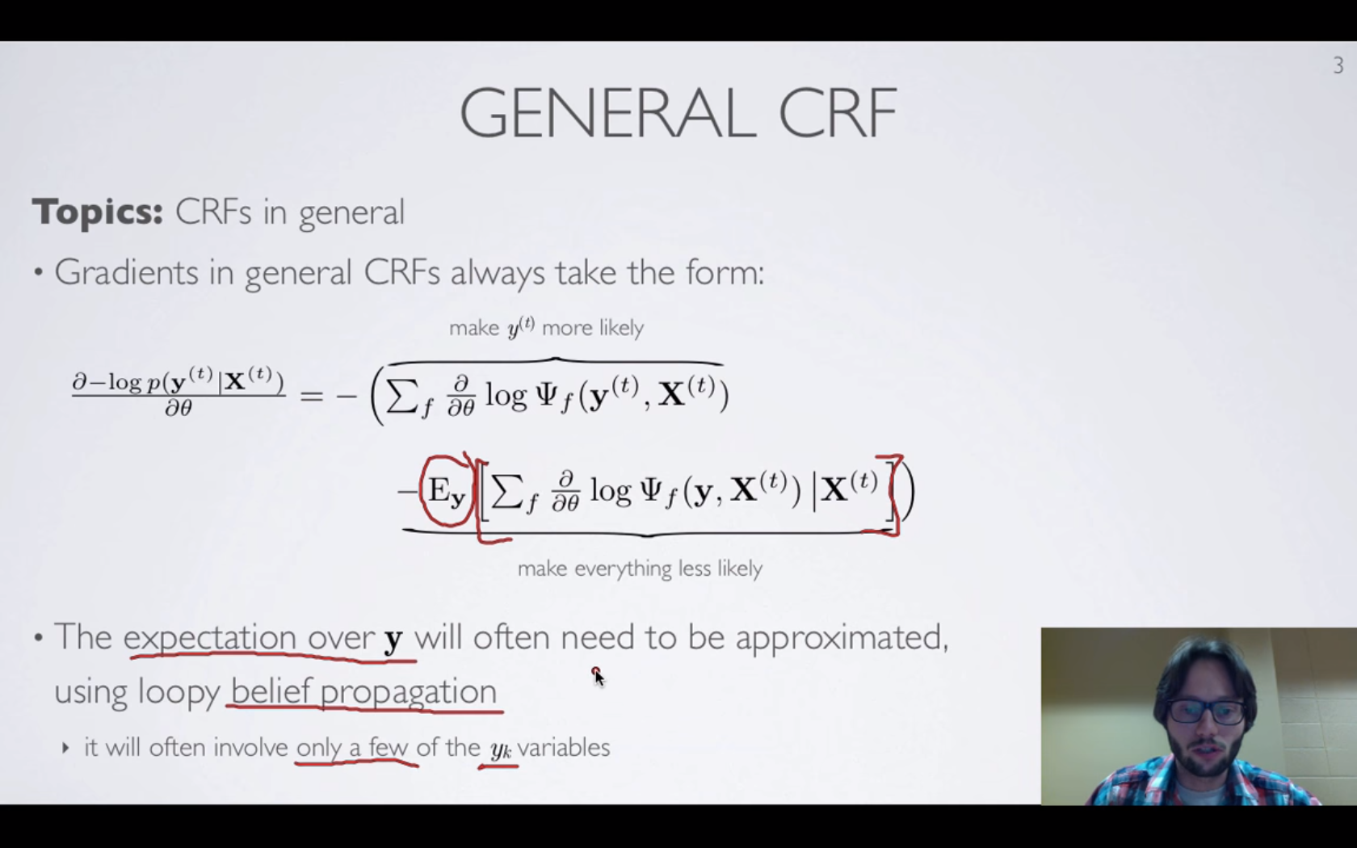
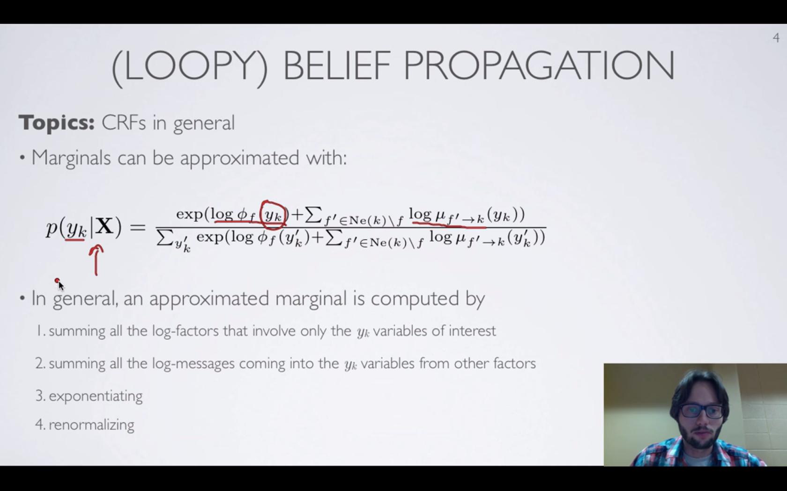
Training CRF -General conditional random field
CRF which is not needlessly linear chain
Training: Gradient Descent
Notes:
4.7

Slide 12
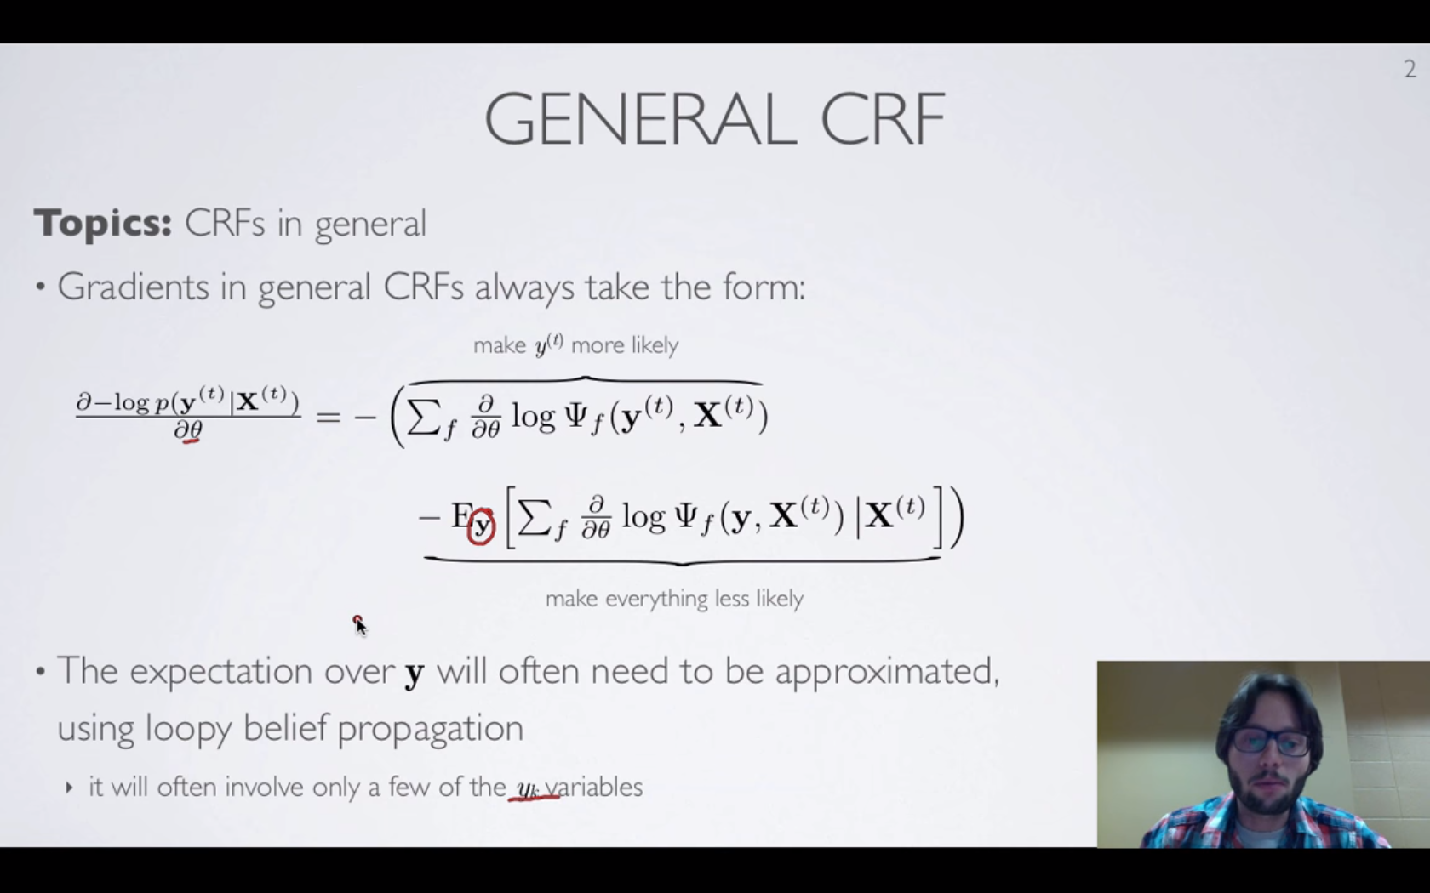
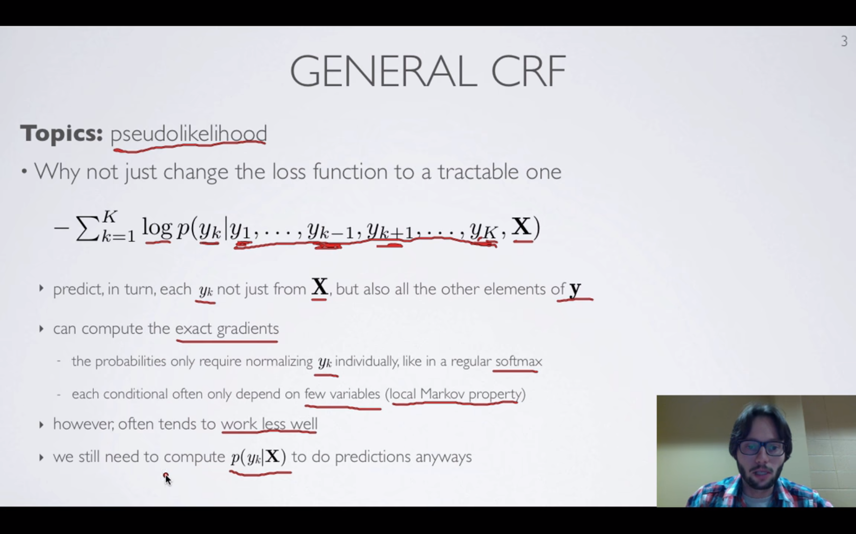
Training CRF -Pseudolikelihood
Pseudolikelihood: Alternative to ML training of CRF
Notes:
4.7

Slide 13
References
From “Neural Network” by Hugo Larochelle. Lec 4.1~4.8
https://www.youtube.com/user/hugolarochelle
Notes:
09-26: ~4.5

